Slide 1
NoSQL

Slide 2

an application: a database with a front-end
DB
E-commerce Website

Slide 3
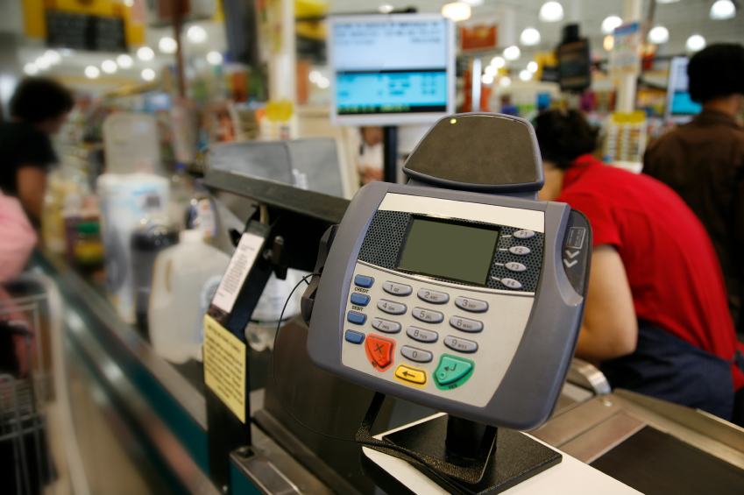
an application: a database with a front-end
DB
Operational Systems

Slide 4
Relational databases
Benefits of Relational databases:
ACID
Strong consistancy, concurrency, recovery
Mathematical background
Standard Query language (SQL)
Lots of tools to use with i.e: Reporting services, entity frameworks, ...

Slide 5
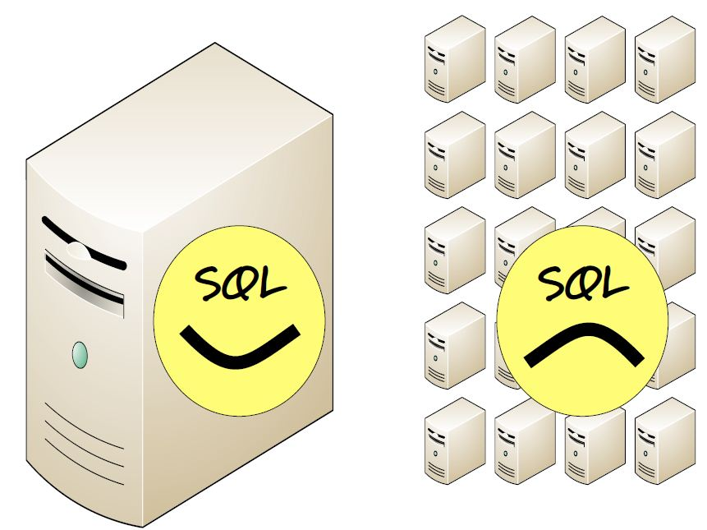
Era of Distributed Computing
But...
Relational databases were not built for distributed applications.
Because...
Joins are expensive
Hard to scale horizontally
Expensive (product cost, hardware, Maintenance)

Slide 6
NOSQL ORIGINS
There have been non-relational database types before, such as the object-oriented databases that arose in the 1990s. Those didn’t take off.
Why not? Possibly because relational databases and SQL were so dominant, and SQL was the language for data integration and data warehousing. Having a few systems with different data models made enterprise-wide integration difficult.

Slide 10
Why Suddenly NOSQL NOW?
Let us answer that using four trends
Data Size
Connectedness
Semi-structure
Architecture

Slide 11
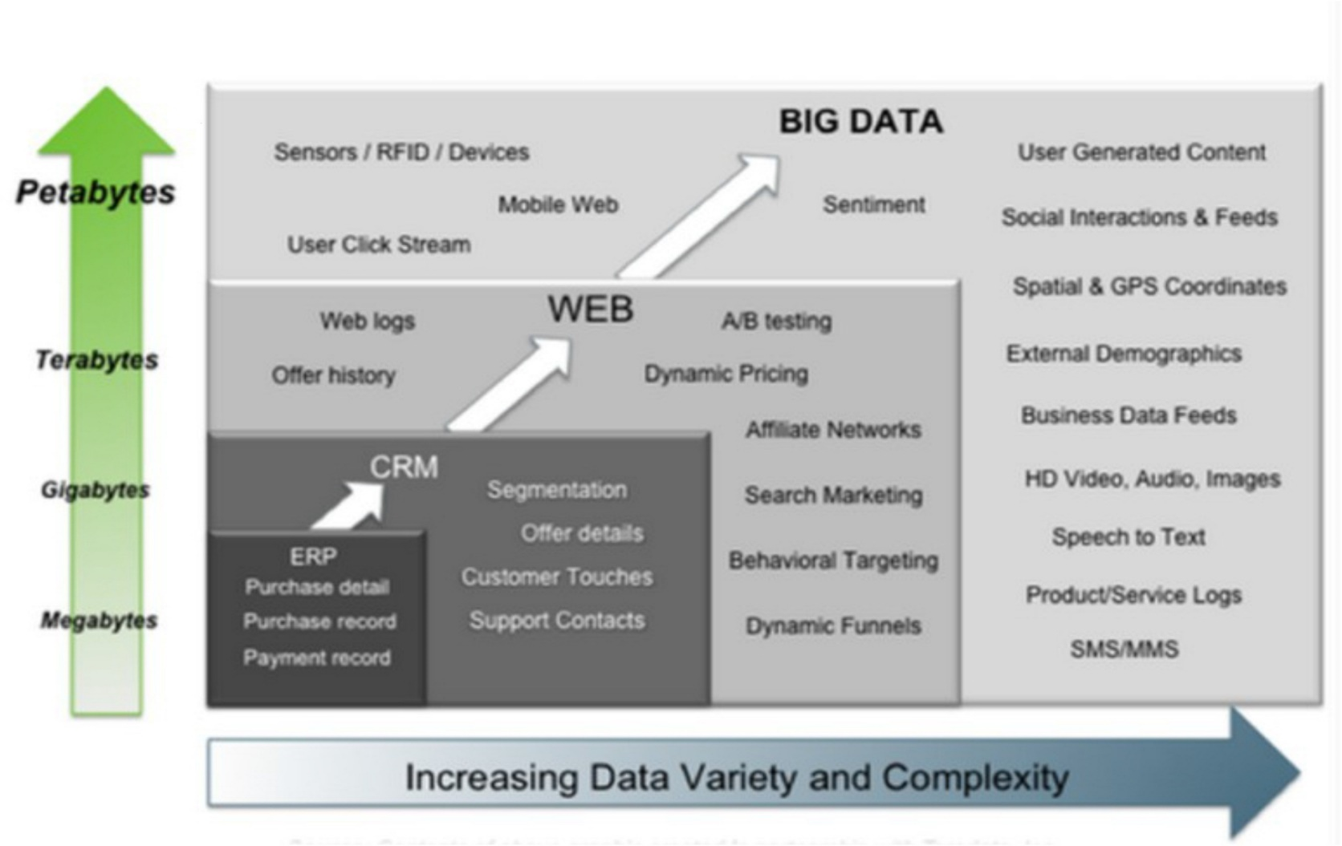
Rise of Big data
Three V(s) of Bigdata:
Volume
Velocity
Variety

Slide 12
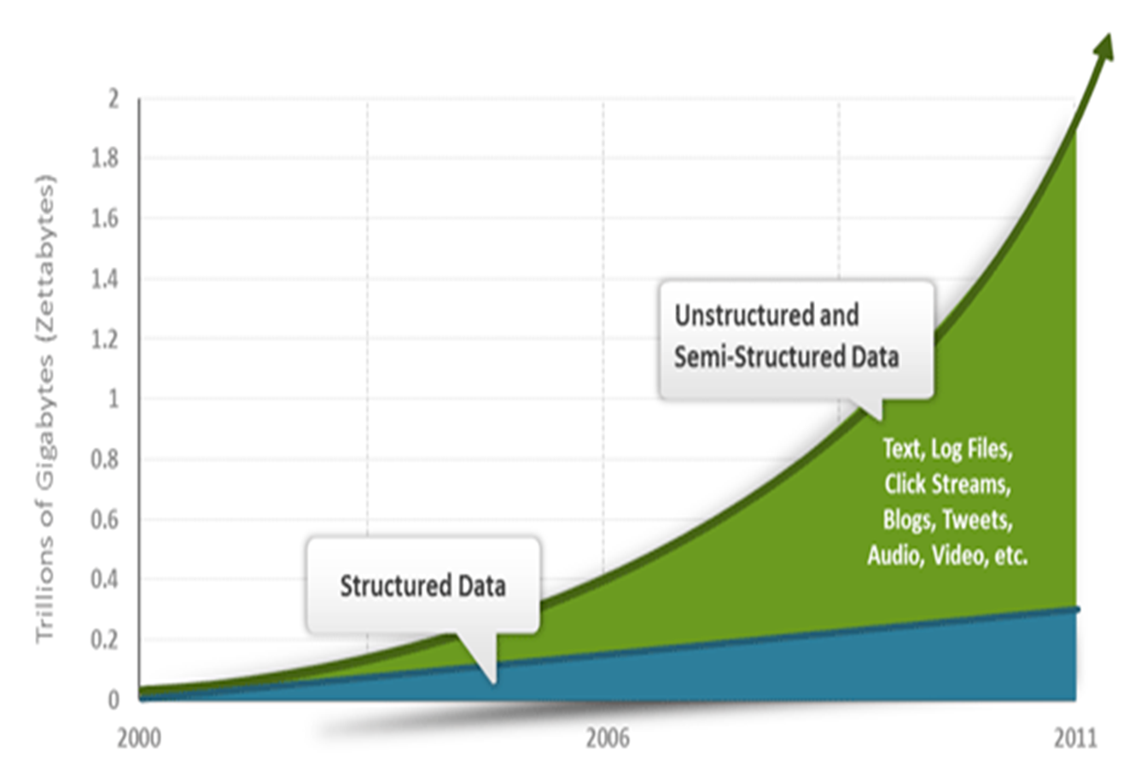
Rise of Big data

Slide 13
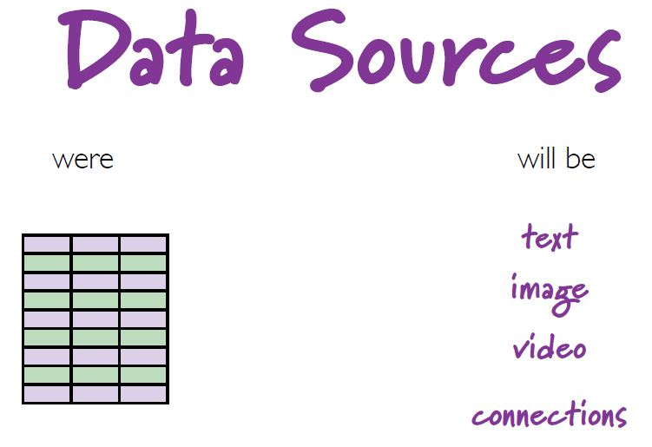
Rise of Big data
Walmart: 1 million transactions per hour
Facebook: 300 million photos
People are talking about petabytes today

Slide 15

NoSQL why, what and when?
Google & Amazon bulit their own databases (Big table & Dynamo)
Facebook invented Cassandra and is using thousands of them
The name doesn’t indicate its characteristics
There is no strict defenition for NoSQL databases
There are more than 230 NoSQL databases (nosql-database.org)

Slide 16
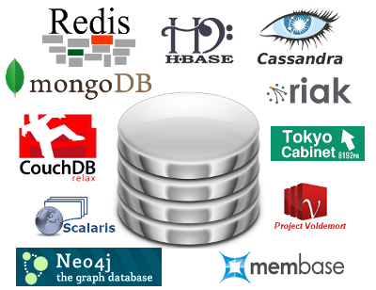
Characteristics of NoSQL databases
Non relational
Cluster friendly
Schema-less
21 century web
Open-source

Slide 17
Characteristics of NoSQL databases
NoSQL avoids:
Overhead of ACID transactions
Complexity of SQL query
Burden of up-front schema design
Provides:
Easy and frequent changes to DB
Horizontal scaling (scaling out)
Solution to Impedance mismatch
Fast development
Notes:
We have acid transactions in graph databases
We have atomicity in an aggregate (a document in MongoDB)

Slide 18










NoSQL is getting more & more popular

Slide 19
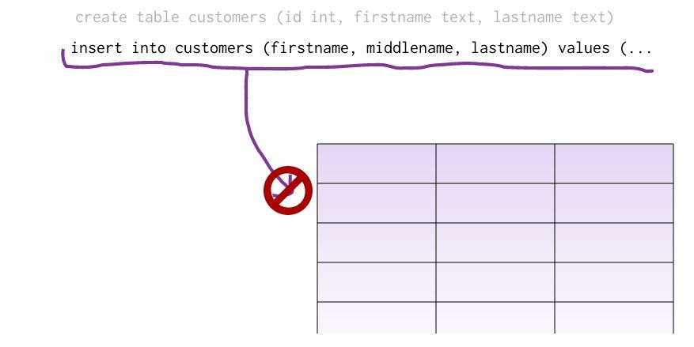
What is a schema-less datamodel?
In relational Databases:
You can’t add a record which does not fit the schema
You need to add NULLs to unused items in a row
We should consider the datatypes. i.e : you can’t add a stirng to an interger field
You can’t add multiple items in a field (You should create another table: primary-key, foreign key, joins, normalization, ... !!!)

Slide 20
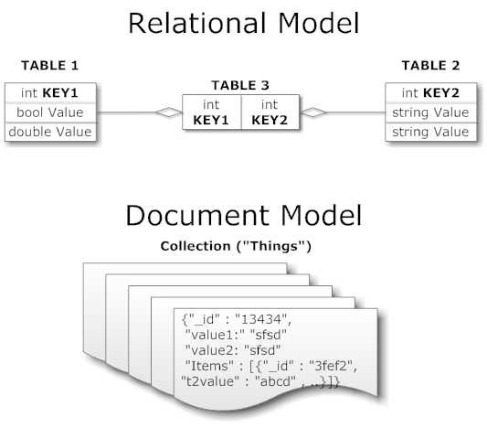
What is a schema-less datamodel?
In NoSQL Databases:
There is no schema to consider
There is no unused cell
There is no datatype (implicit)
Most of considerations are done in application layer
We gather all items in an aggregate (document)

Slide 21
What is Aggregation?
The term comes from Domain Driven Design
Shared nothing architecture
An aggregate is a cluster of domain objects that can be treated as a single unit
Aggregates are the basic element of transfer of data storage - you request to load or save whole aggregates
Transactions should not cross aggregate boundaries
This mechanism reduces the join operations to a minimal level

Slide 22
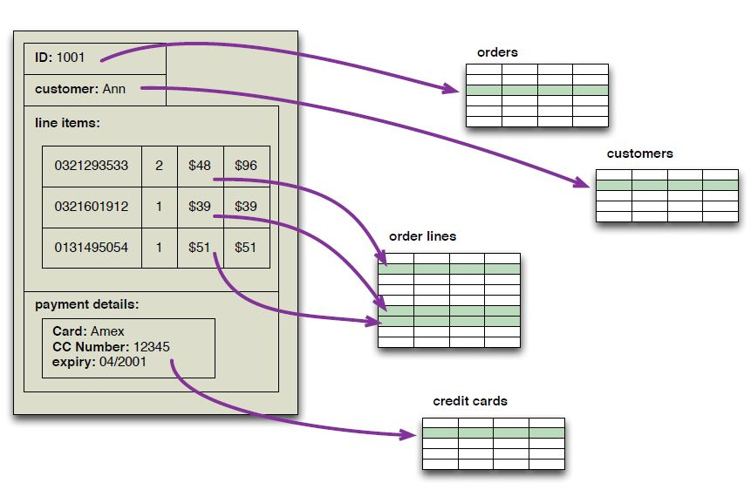
What is Aggregation?

Slide 23
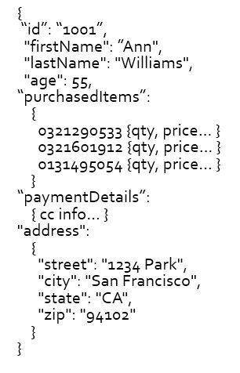
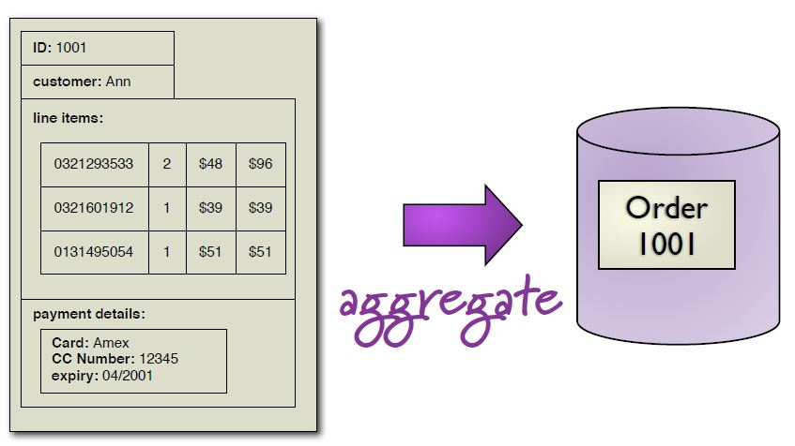
What is Aggregation?

Slide 24
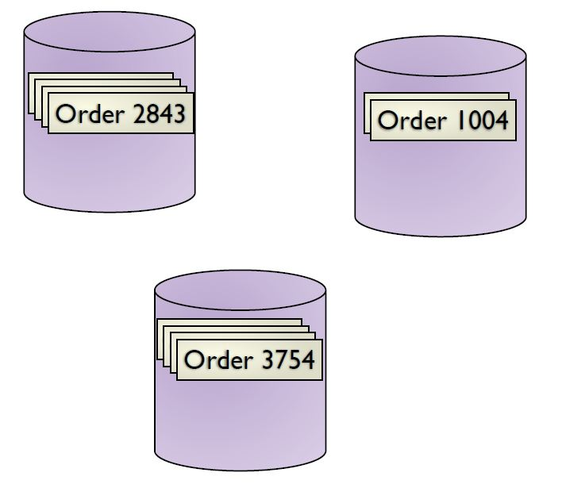
What is Aggregation?

Slide 25
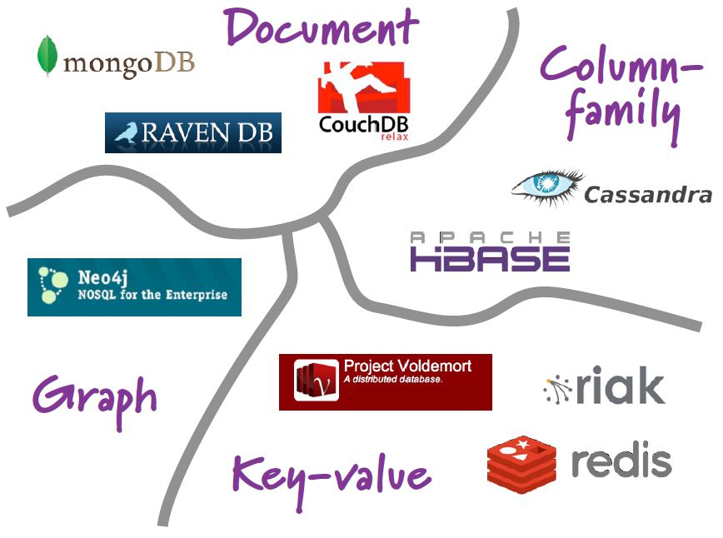
NoSQL Categories
NoSQL databases are classified in four major datamodels:
Key-value
Document
Column family
Graph
Aggregate-oriented

Slide 26

Key-value data model
“One key, one value, no duplicates, and crazy fast.”
It is a Hash!
The value is binary object aka. “blob” – the DB does not understand it and does not want to understand it.
“Value” is stored as a “blob”
- Without caring or knowing what is inside
- Application is responsible for understanding the data
Main observation from Amazon (using Dynamo)
– “There are many services on Amazon’s platform that only need primary-key access to a data store.”
E.g. Best seller lists, shopping carts, customer preferences, session management, sales rank, product catalog

Slide 27
Key-value data model
The main idea is the use of a hash table
Access data (values) by strings called keys
Data has no required format – data may have any format
Data model: (key, value) pairs
Basic Operations:
Insert(key,value), Fetch(key),Update(key), Delete(key)

Slide 28
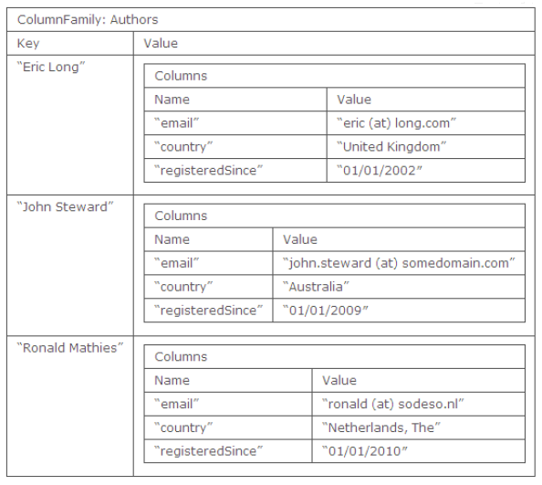
Column family data model
The column is lowest/smallest instance of data.
It is a tuple that contains a name, a value and a timestamp

Slide 29
DOCUMENT STORE: introducing mongodb
Currently the most popular aggregate-oriented NoSQL database, MongoDB is a “document store” that holds data in collections of BSON (binary JSON) documents.
You can think of collections as “tables” and documents as “rows”, but MongoDB collections are schemaless. You could have one collection holding the following documents:
{ _id: 123,
name: ”A Madison",
address: { city:"Chandler", state:"AZ" }
classes: ["CIS440","CIS355"]
}
{ _id: "LOTR",
title: "The Lord of the Rings",
author: "Tolkein, J.R.R.",
genres: ["fantasy","adventure"]
}
{ _id: "000001",
items: ["pound pastrami",
"can kraut",
"six bagels - bring home for Emma"]
}

Slide 30
solving the “impedance mismatch” problem
Complex data structures such as invoices, news articles, user profiles, and so forth are common in web based applications.
In relational databases, each instance of a structure like this would be broken down into parts stored in lots of tables.
Orders
Relational Tables
Order #: 12345 Date: 9/23/2015 Customer: A. Madison Items Ordered:
SKU QTY Subtotal
#42 1 $19.95
#953 2 $8.90
Total: $28.85
Customers
Order Lines
Products

Slide 31
solving the “impedance mismatch” problem
In an aggregate-oriented database like MongoDB, the entire “object” or “natural aggregate” is stored in the database as a complete unit. It can be retrieved with a simple lookup by its primary key.
MongoDB collection
{ _id: "12345",
date: "2015-09-23",
customer: {"lastname": ”Madison",
"firstname": ”A",
"address": ... },
items: [
{"sku":42, "quantity":1, "subtotal":19.95},
{"sku":953, "quantity":2, "subtotal":8.90}
],
total: 28.85
}
Order #: 12345 Date: 9/23/2015 Customer: A. Madison Items Ordered:
SKU QTY Subtotal
#42 1 $19.95
#953 2 $8.90
Total: $28.85
just one write query

Slide 32
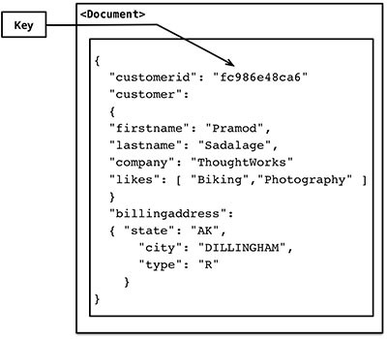
Aggregate-Oriented Databases: Document Stores
When data is distributed over large clusters, it can take a lot of communication and coordination to “re-assemble” an object like an order or a user profile from various tables stored on different servers.
Document stores are databases that instead store these “natural aggregates” together just as they are normally accessed—together.
They typically use JSON, but could use XML, to represent data that may be as simple or as complex as needed.
Each “document” is referenced by a key—an id number or URL that gives it a unique index. Queries very simply ask for the value for a given key.

Slide 33
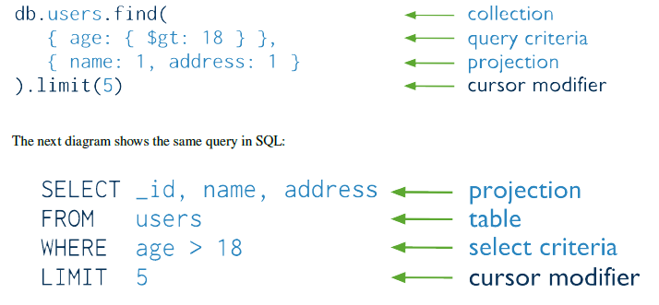
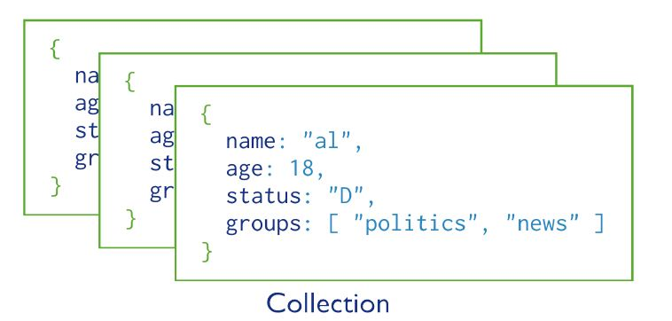

Document-based datamodel
Notes:
Mongodb has auto sharding, map/reduce module

Slide 34
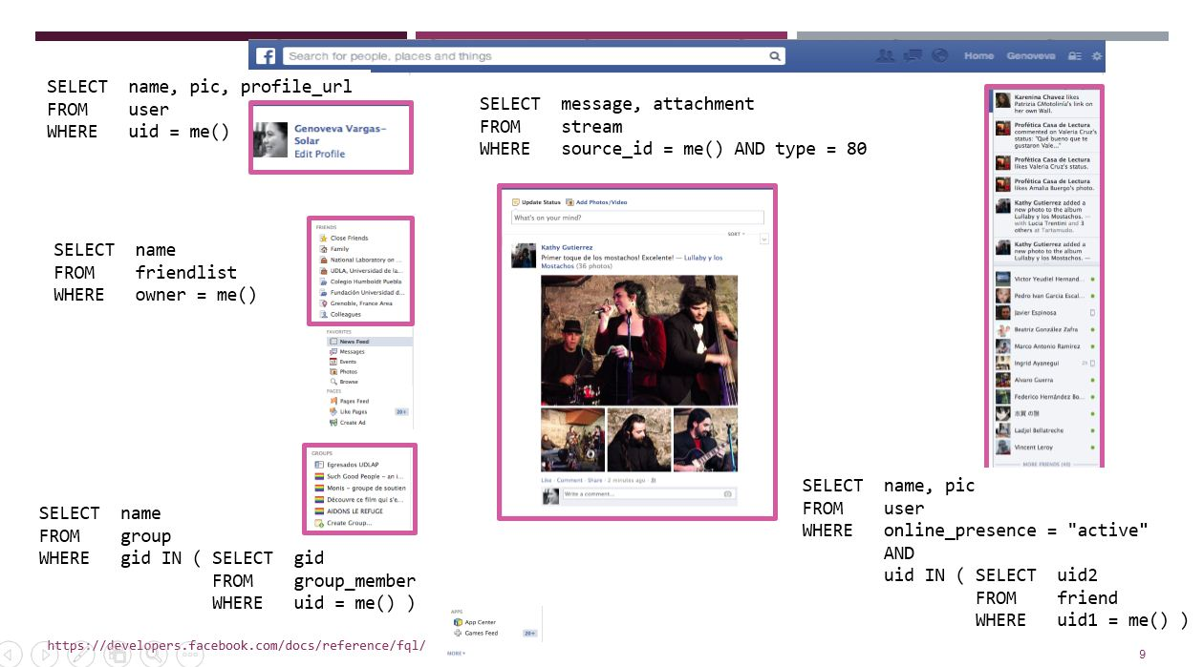
Overview of a Document-based datamodel

Slide 35
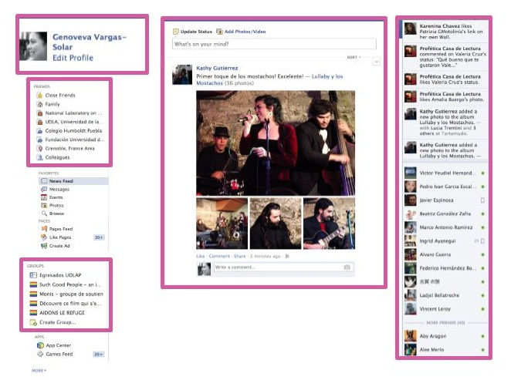

Slide 36
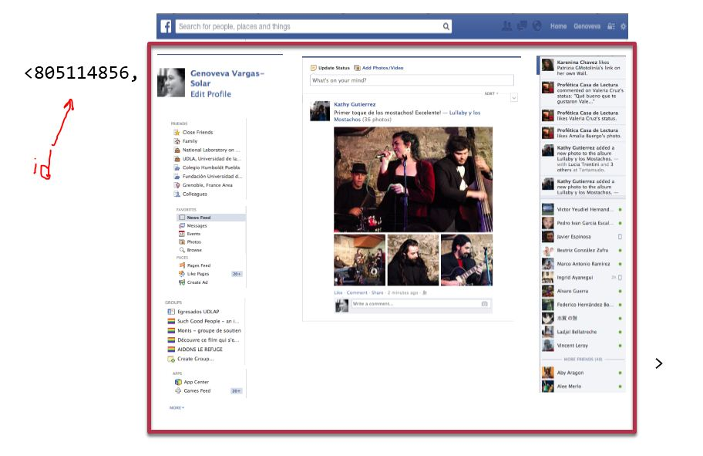

Slide 37
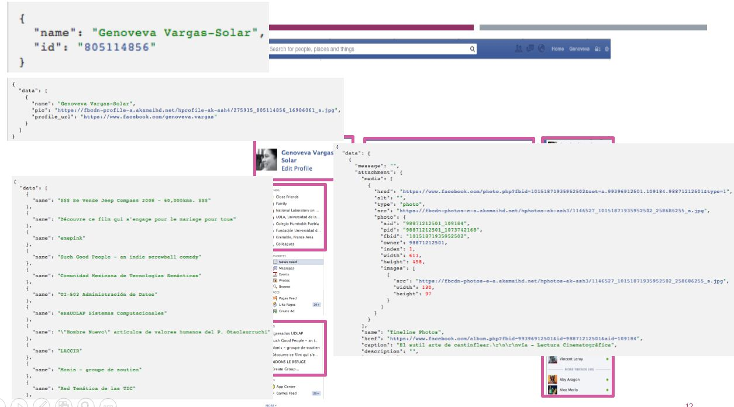
Overview of a Document-based datamodel

Slide 38
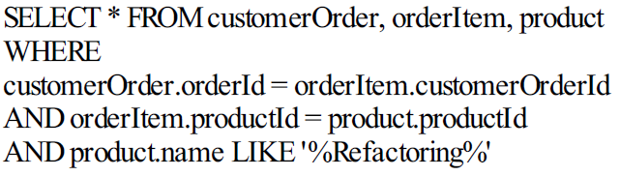
A sample MongoDB query
MySQL:
MongoDB:
There is no join in MongoDB query
Because we are using an aggregate data model

Slide 39
benefits of aggregate-orientation
First: much easier for programmers! No more complex SQL. The “objects” of your program can be stored and retrieved as they are structured naturally.
Second: As you scale out to a cluster, the “natural aggregates” will not be broken up and distributed across nodes. The “document” has a clear boundary that will not be violated.
document integrity is preserved

Slide 40
LESS NEED FOR ACID
Relational databases boast “ACID” Transactions (atomic, consistent, isolated, durable).
The big idea of ACID is that, when lots of people are updating the database at the same time, no transaction will be “half completed”.
This is really important when one “natural aggregate” represents several database operations in a cluster.
In MongoDB (or Riak, Dynamo, CouchDB, etc), the document is the transaction boundary. You may insert, update, or delete a document, and those operations will be atomic and “safe”. Only if you’re updating more than one document will you suffer for lack of ACID guarantees.

Slide 41


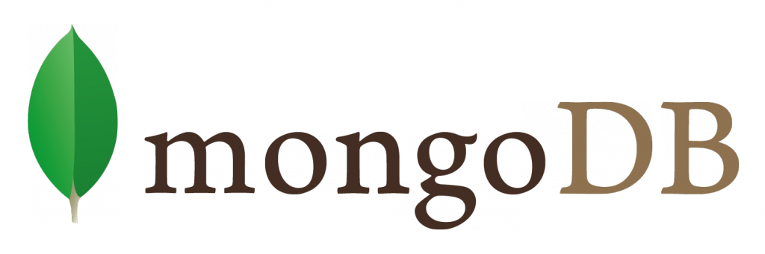
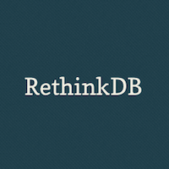
Aggregate-Oriented DBs pro-and-con
Advantages
Keeps data together that’s queried together; this helps with consistency and query speed especially on distributed systems
Allows very complex data structures with lists and nesting
Doesn’t require much up-front design; programmers can develop the schema as they go.
Disadvantages
Less controls on consistency and integrity than in the relational data model.

Slide 42
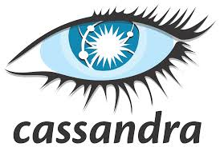
Column family data model
Some statistics about Facebook Search (using Cassandra)
MySQL > 50 GB Data
Writes Average : ~300 ms
Reads Average : ~350 ms
Rewritten with Cassandra > 50 GB Data
Writes Average : 0.12 ms
Reads Average : 15 ms
Notes:
Facebook is using +6000 cassandra dbs.
Have you seen the same with oracle or db2 (RDMS are suitable to upscaling)
That’s how google extend its clusters everyday.

Slide 43
what google needed
Google created BigTable (upon which HBase is modeled) with certain needs in mind:
They have huge, structured data, millions or billions of rows about:
web sites
user profiles
geographic locations
They have many, many asynchronous processes analyzing and updating individual rows in real time. (The system cannot be updated in periodic batches.)
They needed fast response time; for example, when a user is logged in, they may need to access his profile to target search results or advertising.
They also wanted to see how data changed over time (full history of versions).

Slide 44
how bigtable/Hbase works
Data storage in a cluster (i.e. GFS or HDFS for storage).
Data is structured as a giant “table” in which each row has a (primary) key. Key lookup is the only way to retrieve a row – no indexes are natively provided.
The table is sorted, and partitioned horizontally.
Therefore, the data can be spread across a cluster, and yet its location can be known for quick retrieval.
The only data type is “bytes”; the database doesn’t “understand” the data.
The table’s schema is defined by its name and the names of “column families”. Column families are stored together and can have any arbitrary columns. These are not like the kinds of columns you are familiar with in RDBMSs.
All rows/cells are versioned and timestamped, giving you the history of the data’s changes.
rows 1-999
rows 1000-1999
Horizontal partitioning
rows 2000-2999…

Slide 45
Example column-family-oriented database
row keys
column family: info
column family: orders
Here’s an example of a big table containing data on customers and the orders they’ve placed.
Notice that the “info” column family doesn’t have the same columns for each record.
Also, the “orders” column family doesn’t look like it contains what you’d think of as “columns” in SQL.
In fact, this is a NoSQL type, and just like MongoDB it can be very flexible as to what data is stored.
name: Clark
age: 38
state: AZ
order123: {…}
order245: {…}
order456: {…}
1001
order124: {…}
order878: {…}
name: Jones
country: UK
1002

Slide 46
benefits
Because the rows are sorted, data retrieval can be very fast.
Column families can be optimized differently for performance; therefore, data that has similar characteristics (size, access profiles) should be grouped together.
It has no JOIN or INDEX capability natively (although see the Apache Phoenix project for SQL-on-HBase), but this is not needed so much because HBase can handle millions of columns.
Hbase/BigTable requires a lot of tweaking and setup, because it’s designed for high performance. It’s not an easy option like MongoDB, but can be very powerful when dealing with huge datasets.

Slide 47


Graph data model
Based on Graph Theory.
Scale vertically, no clustering.
You can use graph algorithms easily
Transactions
ACID
Notes:
Good for social networks & CS projects

Slide 48
GRAPH DATABASES

Slide 54
review: types and qualities of Nosql databases

Slide 55
size of data × speed of query
SQL RDBMS | BigTable Dynamo NoSQL
☹ | Spark, Pig, Hive
FAST, Interactive
Speed of Query
Slow,Batch
Small-Medium
BIG
Size of Data

Slide 57
common characteristics of nosql
non-relational
cluster-friendly (“scale out”)
mostly open-source
mostly 21st-century web origin
schemaless (although schema is usually implied…)

Slide 58
Aggregate-oriented vs Column-oriented
MongoDB, etc.
HBase, etc.
leverages CAP theorem for services that are write-once, read-many-times
great at storing lots of small “chunks” of objects (users, messages, articles, etc)
replaces RDBMS at massive scale
somewhat flexible schema
handles millions of columns, billions of rows

Slide 59
RDBMS vs nosql
RDBMS
NoSQL
scale “up”
structured data
atomic transactions
impedance mismatch (a challenge for programmers)
scale “out”
semi-structured or unstructured data
eventual consistency
stores data in the object model of the program (and mental model of user)

Slide 60
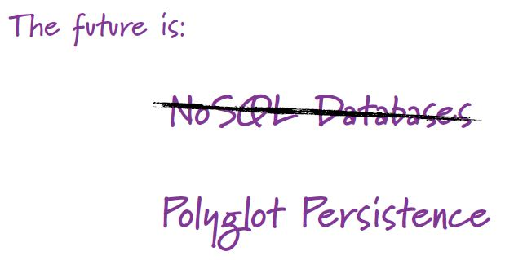
Polyglot persistence : the future of database systems
Future databases are the combination of SQL & NoSQL
We still need relational databases

Slide 61
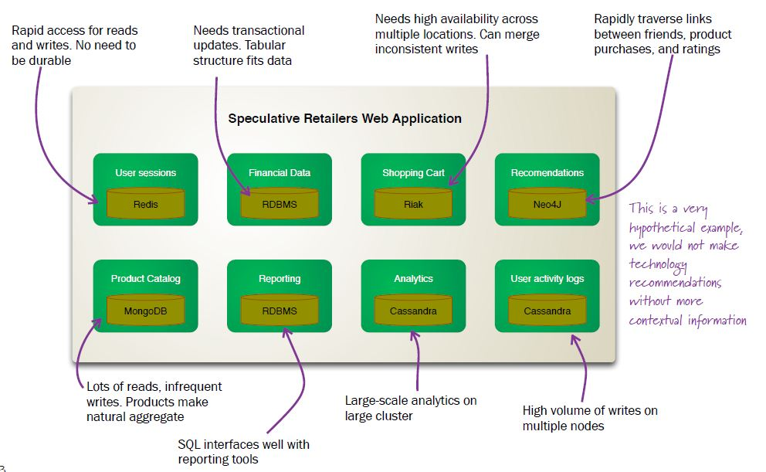
Overview of a polygot db

Slide 62
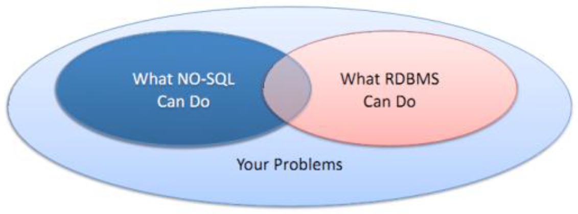
Conclusion: Before you choose NoSQL as a solution:
Notes:
Dental clinic example – xml as a solution – nosql as solution
Facebook query example : show me a female < 30 who is intested in y music living in z
Most of projects have some custom tables

Slide 63
Why NoSQL?
Schema-free
Massive data stores
Scalability
Some services simpler to implement than using RDBMS
Great fit for many “Web 2.0” services
Notes:
Why you should thing a NoSQL solution for your next project?
Being schema-free is a HUGE help for many problems. And it almost always makes the life of developer much more pleasant.
If you need to store massive amount of data, or know you need to scale easily, NoSQL might be for you.
I could also claim that some services are perhaps easier to implement with a NoSQL solution that with a relational database.
And this very true for many simple Web 2.0 services.

Slide 64
Why NOT NoSQL
DRBMS databases and tools are mature
NoSQL implementations often “alpha”
Data consistency, transactions
“Don’t scale until you need it”
Notes:
Then, why NoSQL is not always the best choice.
First, relational databases have been around for many decades, and they are mature. The developer tools are mature.
NoSQL solutions, on the other hand, are often new projects with great ideas and even greater promises, but only “alpha” quality.
If you need strong data consistency, or if you need uncompromised support for transactions, use a relational database.
And the last point. We often tend to think of scalability issues too early. It might not be a bad choice to write an application with the tools you know best, and when the time hits, and you need to scale, then think if a NoSQL solution could solve some of your scalability issues.

Slide 65
RDBMS vs. NoSQL
Strong consistency vs. Eventual consistency
Big dataset vs. HUGE datasets
Scaling is possible vs. Scaling is easy
SQL vs. Map-Reduce
Good availability vs. Very high availability
Notes:
This is my last slide.
If you want to compare relational databases with NoSQL databases, these could be the main points.
We talked about consistency. In relational model, with ACID operation, it is very strong.
Relational databases support rather big datasets, but some NoSQL give you almost unlimited scalability in terms of data size.
Scaling can mean many things, but you could safely say that NoSQL solutions usually scale up much better than relational databases do.
SQL is wonderful query language and NoSQL solutions often do not support any kind of query language. If they do, the languages are likely not as expressive as SQL is. On the other hand, Map-Reduce can solve some problems very efficiently.
And in theory at least, high availability is also easier achieved with many NoSQL solutions.
And remember, NoSQL solutions are very different from each other. And this slide perhaps simplifies things too much. But it is still a very good slide to finish this presentation.
Thank you!

Slide 67
BASICS

Slide 68
PRO-SQL

Slide 69
Not SO Good about SQL

Slide 70
Pro-NOSQL

